Slide 1
The Impact of World Oil Price Shocks on Maize Prices in East Africa
Brian M. Dillon and Christopher B. Barrett
  Monash University seminar
  May 8, 2013

Slide 2
Motivation
2008 and 2011 global food and oil price spikes:
  Widespread, high-level concern about the impact of global commodity market price shocks on developing countries
  Considerable pundit and scholar focus on oil-food price links, especially due to ethanol production and fertilizer prices.
  Yet the relevance of those links is questionable in poor countries that use little fertilizer or biofuels.

Slide 3
Motivation
  Inter-commodity spatio-temporal price transmission:
  Deaton (1999, p.24) “the understanding of commodity prices and the ability to forecast them remains seriously inadequate. Without such understanding, it is difficult to construct good policy rules.” That concern remains today.
  Under-researched, but potentially important topic, especially for locating appropriate government interventions (if any) to dampen price increases.
  Our results underscore importance of post-harvest distribution systems as well as productivity growth.

Slide 4
Motivation
Central questions of this paper
Do global oil price shocks impact food prices in local (sub-national) markets in low-income countries where subsistence food production is widespread?
If so, how much and by what mechanisms?
We tackle those questions, focusing on maize markets within Ethiopia, Kenya, Tanzania and Uganda, using a newly assembled data set of local, monthly average maize and petrol prices from 17 sub-national markets, January 2000 – November 2012.

Slide 5
Motivation
3 Prospective oil price – maize price linkages:
Farmers’ input costs – fertilizers, machinery fuel
We ignore this b/c use rates negligible in all but Kenya.
With available data, we test if fertilizer could be a channel in Kenya, but find no support for that hypothesis. That’s the expected result as Kenya is a price-taker on international grain markets.

Slide 6
Motivation
3 Prospective oil price – maize price linkages:
Biofuels and US ethanol mandate
Historically, weak oil and maize price connection. But 2005 US Energy Policy Act thought to link them now due to corn ethanol conversion into biofuel.
Yet, literature typically finds no causal effects.
We similarly test but find no causal effect of oil prices on maize prices.

Slide 7
Motivation
3 Prospective oil price – maize price linkages:
Fuel and transport costs
Prospectively important b/c of low value-to-weight of grains, and in east Africa, rudimentary transport infrastructure, heavily dependence on truck/lorry service, and long distances to some markets.
We find global oil prices indeed influence subnational, local market maize prices through fuel prices.

Slide 8
Background
Maize is the key food grain of east Africa
  Largest single crop in terms of area planted and a major source of income for farmers.
  Single largest source of calories in diets
  Very sensitive issue politically, so government interventions are routine, albeit far less than pre-2000, following market liberalization
  All countries trade (near-)continuously on int’l markets, but volumes small share of consumption/ production (except occasionally in Kenya)

Slide 9
Background
  East African economies are pure oil importers
  Only Kenyan has any domestic fuel refining capacity
  Ethiopia administratively fixes fuel prices, market reigns in other three economies

Slide 10
Data
Monthly price series, January 2000 – November 2012
  Petrol and maize for each of 17 subnational urban markets, which we assembled from various sources.
  Global oil and maize price data from World Bank
  CPI and USD exchange rate data from IMF

Slide 11
Global oil-maize prices
Global oil and maize prices are strongly correlated (r=0.83 in nominal terms, =0.45 in real 2005 terms)

Slide 12
Global crude oil – national petrol prices
Global crude oil and East African port of entry (POE) petrol prices are strongly correlated

Slide 13
Global – national maize prices
Global and East African POE maize prices are also strongly correlated, but w/more (seasonal) deviations

Slide 14
Empirical strategy
Identifying Assumptions
1) All four countries are price-takers on int’l markets. So global market prices weakly exogenous.
2) Within region, no feedback from maize prices to fuel prices (no ethanol production; maize haulage modest share of freight), so fuel prices are weakly exogenous.
3) Within countries, disequilibrium between POE prices and those in another market j is resolved through adjustment in market j, reflecting that these are price-taking markets routinely connected through trade.
4) Exchange rates weakly exogenous to POE prices. (Verified in Appendix.)

Slide 15
Empirical strategy
Sequence of bilateral price transmission models
- Allows for country-specific links to global markets, and differential price transmission along distinct within-country links.

Slide 16
Empirical strategy
1. Estimating the global oil-maize price relationship
Both are I(1) series.
No evidence of cointegration using any of multiple specifications and tests. Others have found similar result.
These results hold even for the post-Oct 2006 subsample after US ethanol mandate begins.
In the absence of any clear, stationary long-run equilibrium relationship between the two series, we estimate a reduced form VAR (in 1st diffs).

Slide 17
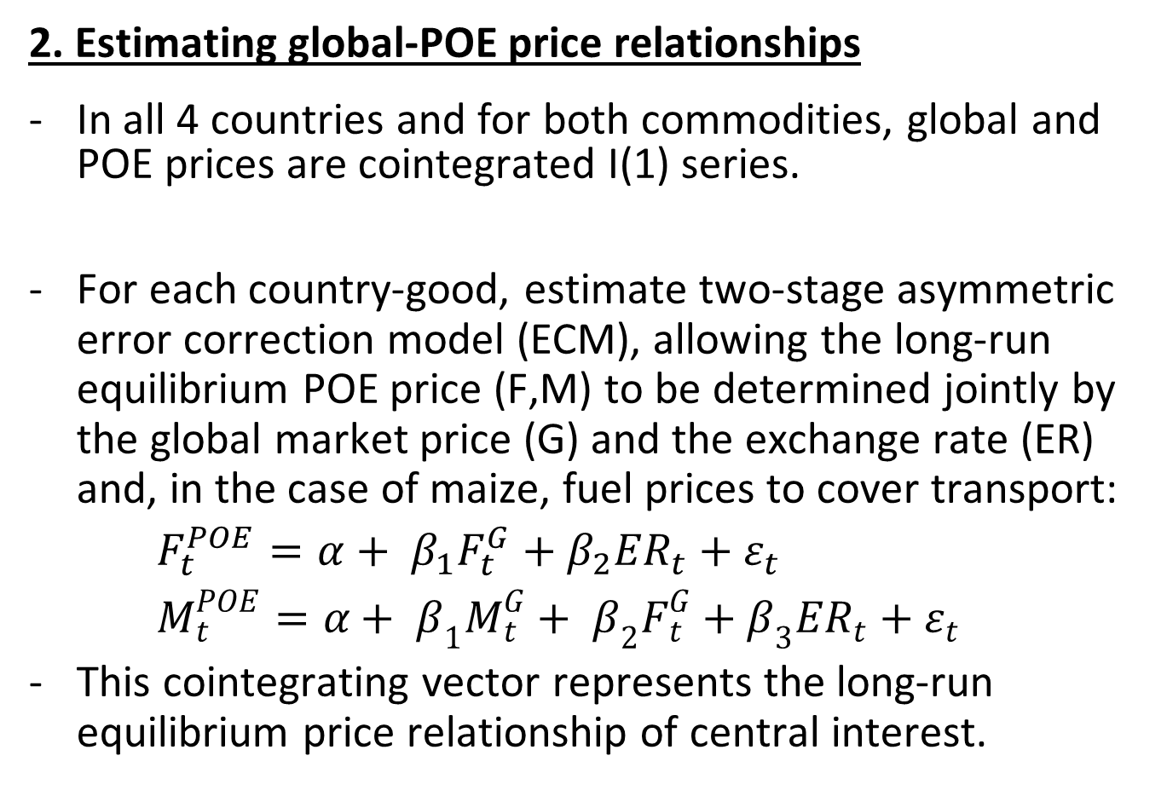
Empirical strategy
2. Estimating global-POE price relationships
In all 4 countries and for both commodities, global and POE prices are cointegrated I(1) series.
For each country-good, estimate two-stage asymmetric error correction model (ECM), allowing the long-run equilibrium POE price (F,M) to be determined jointly by the global market price (G) and the exchange rate (ER) and, in the case of maize, fuel prices to cover transport:
$F_{t}^{POE}=α+ β_{1}F_{t}^{G}+β_{2}{ER}_{t}+ε_{t}$
$M_{t}^{POE}=α+ β_{1}M_{t}^{G}+ β_{2}F_{t}^{G}+β_{3}{ER}_{t}+ε_{t}$
This cointegrating vector represents the long-run equilibrium price relationship of central interest.

Slide 18
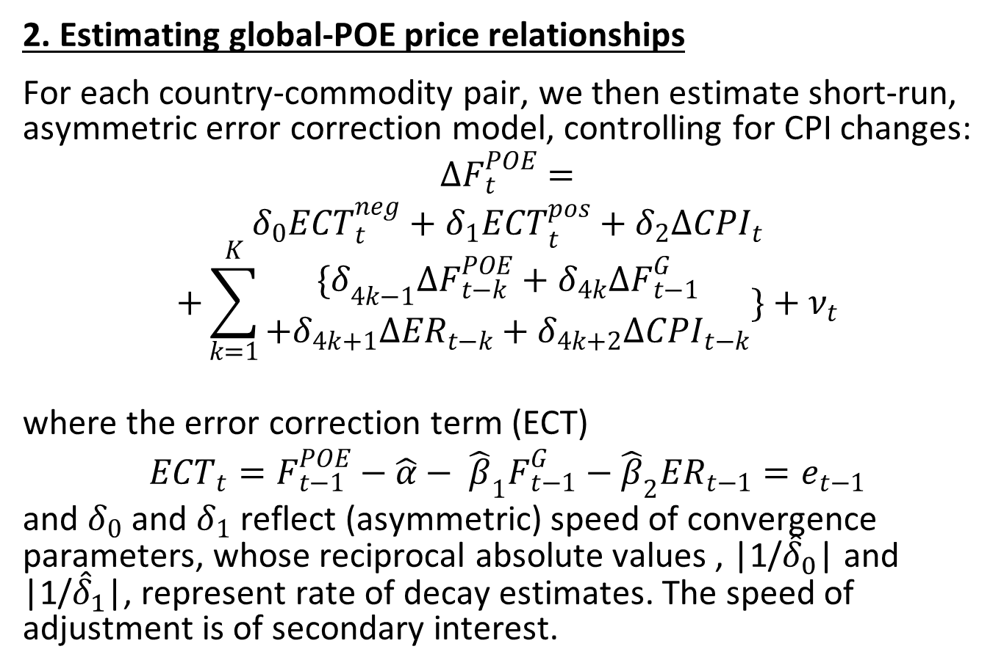
Empirical strategy
2. Estimating global-POE price relationships
For each country-commodity pair, we then estimate short-run, asymmetric error correction model, controlling for CPI changes:
$$∆F_{t}^{POE}=$$
$$δ_{0}{ECT}_{t}^{neg}+{δ_{1}ECT}_{t}^{pos}+δ_{2}∆{CPI}_{t}$$
$$+\sum_{k=1}^{K}{\begin{aligned}{\{δ}_{4k−1}∆F_{t−k}^{POE}+δ_{4k}∆F_{t−1}^{G} \\ +δ_{4k+1}∆{ER}_{t−k}+δ_{4k+2}∆{CPI}_{t−k}\end{aligned}}\}+ν_{t}$$
where the error correction term (ECT)
$${ECT}_{t}=F_{t−1}^{POE}−\hat{α}− {\hat{β}}_{1}F_{t−1}^{G}−{\hat{β}}_{2}{ER}_{t−1}=e_{t−1}$$
and $δ_{0}$ and $δ_{1}$ reflect (asymmetric) speed of convergence parameters, whose reciprocal absolute values , |1/${\hat{δ}}_{0}$| and |1/${\hat{δ}}_{1}$|, represent rate of decay estimates. The speed of adjustment is of secondary interest.

Slide 19
Empirical strategy
3. Estimating domestic price transmission
For each market/commodity, follow same approach as in step 2 now with POE price as weakly exogenous.
All non-POE market price series are also I(1) series and cointegrated with POE series.
Estimate cointegrating vector (w/o exchange rate), controlling for fuel prices associated with variable transport costs of maize to get long-run price relationship.
Then estimate asymmetric ECM to estimate the short-run price adjustment dynamics.

Slide 20
Results
1. Global price linkages
We find no effect of lagged or contemporaneous oil prices on maize prices.
We find positive changes in maize prices do tend to drive up oil prices (consistent with Serra et al. 2011).
We take these results as evidence that no meaningful causal relationship exists from exogenous global crude oil price increases to global maize prices.
Strong correlation in global crude oil and maize prices appear due to correlated shocks (Gilbert 2010, Byrne et al. 2013).

Slide 21
Results
1. Global price linkages
Table 5. VAR results, global oil and maize prices (Nominal)
 | Jan 1990 - Nov 2012 | Oct 2006 - Nov 2012
Oil price equation
LD.Oil price ($/bl) | 0.365*** | 0.376***
 | 0.057 | 0.11
LD.Maize price ($/mt) | 0.080*** | 0.107*
 | 0.024 | 0.048
Constant | 0.129 | 0.087
 | 0.231 | 0.73
R² | 0.216 | 0.295
Maize price equation
LD.Oil price ($/bl) | -0.105 | 0.001
 | 0.151 | 0.3
LD.Maize price ($/mt) | 0.211*** | 0.122
 | 0.063 | 0.131
Constant | 0.657 | 2.391
 | 0.611 | 1.994
R² | 0.04 | 0.015
N | 272 | 73

Slide 22
Results
2. Global oil – POE petrol price linkages
On average, a 1% increase in the price of oil on world markets leads to an increase in the long-run POE petrol price of 0.38-0.46%, with estimates remarkably similar across countries.
Petrol price elasticities wrt exchange rate are higher, ranging from 0.85 in Kenya to 1.52 in Ethiopia.
Adjustment back to the long-run equilibrium is not instantaneous, but is still reasonably fast on average, ranging from 2-7 months.
Increases in global oil prices transmit faster than decreases, although differences often not stat. signif.

Slide 23
Results
2. Global oil – POE petrol price linkages
Table 6. POE fuel and global oil, first-stage ECM results
 | Ethiopia | Kenya | Tanzania | Uganda
Global oil ($/bl) | 0.053 | 0.621 | 8.667 | 14.507
 | 0.004 | 0.014 | 0.451 | 0.531
Exchange rate (local/$) | 1.194 | 0.792 | 1.262 | 1.182
 | 0.041 | 0.059 | 0.069 | 0.06
Constant | -7.322 | -22.018 | -839.344 | -911.665
 | 0.325 | 4.251 | 66.468 | 104.065
R² | 0.955 | 0.94 | 0.96 | 0.94
N | 141 | 177 | 126 | 147
Pass-through elasticity (oil) | 0.380 | 0.463 | 0.435 | 0.383
Pass-through elasticity (ER) | 1.519 | 0.854 | 1.219 | 1.036
Mean dep. variable | 8.14 | 69.55 | 1282.60 | 2175.71

Slide 24
Results
2. Global oil – POE petrol price linkages
Table 7. POE fuel and global oil, second-stage asymmetric ECM results
 | Ethiopia | Kenya | Tanzania | Uganda
L.ECT^{neg} | -0.187*** | -0.140*** | -0.562*** | -0.298***
L.ECT^{pos} | -0.132*** | -0.144*** | -0.097 | -0.186***
D.Domestic CPI | 0.013 | 0.192*** | -4.804 | 2.62
LD.POE price (Local/L) | 0.360*** | 0.203*** | 0.023 | 0.180**
LD.Global oil ($/bl) | 0.008 | 0.164*** | 1.035 | -1.172
LD.ER (Local/$) | 0.177 | 0.305*** | -0.024 | 0.270*
LD.Domestic CPI | 0.001 | -0.022 | -1.853 | -0.400
R² | 0.51 | 0.65 | 0.36 | 0.25
N | 139 | 145 | 121 | 145
F test: asymmetric (p-val) | 0.447 | 0.937 | 0.001 | 0.24
Mean POE price (Local/L) | 7.90 | 67.95 | 1240.75 | 2146.19

Slide 25
Results
3. Global – POE maize price linkages
Estimated pass-through elasticities a bit higher than for oil, but also more heterogeneous across countries, ranging from 0.22-0.82 (mean=0.44).
Long-run pass-through elasticities of POE maize wrt global oil prices range 0.20-0.36. In Kenya, by far the biggest maize importer in the region, elasticity wrt global oil prices > wrt global maize prices, underscoring transport costs’ importance.
Short-run adjustment not affected by oil prices.
Adjustment slower than for oil and asymmetric. Higher-than-equilibrium POE maize prices never persist beyond the next harvest, disappearing in 5-6 months in each country. Lower-than-equilibrium prices persist longer.

Slide 26
Results
3. Global – POE maize price linkages
Table 8. POE maize and global maize, first-stage ECM results
 | Ethiopia | Kenya | Tanzania | Uganda
Global maize ($/mt) | 0.012 | 0.026 | 0.733 | 1.201
 | 0.003 | 0.014 | 0.198 | 0.414
Global oil ($/bl) | 0.013 | 0.096 | 0.847 | 1.546
 | 0.004 | 0.03 | 0.41 | 0.779
Exchange rate (local/$) | 0.041 | 0.491 | 0.081 | 0.272
 | 0.038 | 0.071 | 0.017 | 0.056
Constant | -0.779 | -29.131 |  | -408.556
 | 0.246 | 5.28 |  | 89.542
R² | 0.721 | 0.604 | 0.664* | 0.682
N | 144 | 143 | 144 | 135
Pass-through elasticity (maize) | 0.823 | 0.215 | 0.436 | 0.467
Pass-through elasticity (oil) | 0.356 | 0.306 | 0.195 | 0.235
Pass-through elasticity (ER) | 0.202 | 2.140 | 0.383 | 1.334
Mean dep. variable | 2.039 | 17.538 | 244.617 | 394.433

Slide 27
Results
3. Global – POE maize price linkages
Table 9. POE maize and global maize and oil, second-stage asymmetric ECM results
 | Ethiopia | Kenya | Tanzania | Uganda
L.ECT^{neg} | -0.062 | -0.047 | -0.063 | -0.134*
L.ECT^{pos} | -0.202*** | -0.178*** | -0.124*** | -0.172***
D.Domestic CPI | 0.035*** | 0.184** | 4.115** | 5.333*
LD.POE price (Local/L) | 0.13 | 0.266*** | 0.333*** | 0.275***
LD.Global maize ($/mt) | -0.004** | 0.029* | -0.211 | 0.381
LD.Global oil ($/bl) | 0.001 | -0.04 | -0.298 | -0.918
LD.ER Local/USD | -0.029 | 0.145 | -0.065 | -0.073
LD.Domestic CPI | -0.003 | 0.035 | 0.525 | 0.167
R² | 0.47 | 0.23 | 0.25 | 0.20
N | 142 | 141 | 142 | 133
F test: asymmetric (p-val) | 0.031 | 0.105 | 0.354 | 0.676
Mean POE price (Local/L) | 2.04 | 17.54 | 244.62 | 394.43

Slide 28
Results
4. Domestic fuel price transmission
Fuel markets are very well integrated across space within the study countries.
Long-run equilibrium price relationship estimates correspond quite closely with the law of one price.
In short-run adjustment, POE price increases transmit faster (<2 months in most cases) than POE price decreases, although differences not always stat sign.

Slide 29
Results
4. Domestic fuel price transmission
Table 10. Within-country fuel price transmission, ECM stage 1, 2000-2012
Country | Market | POE fuel price | Constant | R² | N | Pass-through elasticity
Ethiopia | Bahir Dar | 1.034 | -0.108 | 0.996 | 141 | 1.013
 | Dire Dawa | 1.099 | -0.752 | 0.998 | 141 | 1.092
 | M'ekele | 1.06 | -0.304 | 0.998 | 141 | 1.037
Kenya | Kisumu | 0.972 | 2.790 | 0.988 | 171 | 0.959
 | Nairobi | 0.977 | 3.271 | 0.991 | 171 | 0.953
 | Nakuru | 1.001 | 0.244 | 0.992 | 171 | 0.996
Tanzania | Arusha | 1.015 | 17.470 | 0.984 | 126 | 0.987
 | Dodoma | 1.023 | -10.941 | 0.990 | 126 | 1.008
 | Kigoma | 1.114 | 9.474 | 0.980 | 126 | 0.993
 | Mbeya | 1.054 | 1.358 | 0.990 | 126 | 0.999
Uganda | Gulu | 1.027 | 23.772 | 0.992 | 147 | 0.989
 | Mbale | 1.012 | -33.272 | 0.993 | 147 | 1.015
 | Mbarara | 1.010 | 21.820 | 0.994 | 147 | 0.990

Slide 30
Results
4. Domestic fuel price transmission
Table 11. Within-country fuel price transmission, asymmetrical ECM stage 2, 2000-2012
 | Market | L.ECT^{neg} | L.ECT^{pos} | LD.POE price | LD.own price | R² | N | F test: asymmetric (p-val)
Ethiopia | Bahir Dar | -0.671*** | -0.205 | 0.388* | 0.134 | 0.31 | 139 | 0.065
 | Dire Dawa | -0.444** | -0.307 | 0.276 | 0.281 | 0.29 | 139 | 0.686
 | M'ekele | -0.586** | -0.276 | 0.381 | 0.165 | 0.30 | 139 | 0.294
Kenya | Kisumu | -0.109 | 0.126 | 0.463*** | -0.057 | 0.23 | 169 | 0.072
 | Nairobi | -0.220* | 0.080 | 0.129 | 0.315** | 0.24 | 169 | 0.052
 | Nakuru | -0.323** | -0.264** | 0.455*** | -0.052 | 0.27 | 169 | 0.708
Tanzania | Arusha | -0.671*** | -0.424*** | -0.001 | 0.059 | 0.23 | 124 | 0.189
 | Dodoma | -0.430*** | -0.273 | 0.241* | 0.067 | 0.19 | 124 | 0.499
 | Kigoma | -0.637*** | -0.223* | 0.433*** | -0.121 | 0.37 | 124 | 0.017
 | Mbeya | -0.488*** | -0.323** | 0.098 | 0.106 | 0.16 | 124 | 0.428
Uganda | Gulu | -0.508*** | -0.001 | 0.719*** | -0.573*** | 0.27 | 145 | 0.023
 | Mbale | -0.737*** | -0.404* | 0.414** | -0.325** | 0.24 | 145 | 0.237
 | Mbarara | -0.461** | -0.110 | 0.342** | -0.152 | 0.15 | 145 | 0.154

Slide 31
Results
5. Domestic maize price transmission
As with domestic fuel price transmission, most estimates indicate strong spatial market integration, in most cases corresponding to the law of one price in long-run equilibrium.
Within-country maize price transmission elasticities are lower for the four markets in TZ/UG furthest from coastal POE markets.
The remote markets also have the highest pass-through elasticities wrt local fuel prices: 0.29-0.76, often ≥ POE grain price pass-through.
Short-run adjustment back to equilibrium is quick, typically < 3 months and fuel prices play little or no role in short-run dynamics, just as with global-POE price dynamics.

Slide 32
Results
5. Domestic maize price transmission
Table 12. Within-country maize price transmission, ECM stage 1, 2000-2012
 |  | Pass-through elasticities
Country | Market | POE maize | Own petrol
Ethiopia | Bahir Dar | 0.991 | 0.005
 | Dire Dawa | 0.916 | 0.030
 | M'ekele | 0.894 | -0.046
Kenya | Kisumu | 1.028 | 0.209
 | Nairobi | 0.928 | 0.109
 | Nakuru | 1.144 | 0.014
Tanzania | Arusha | 0.937 | 0.051
 | Dodoma | 1.011 | 0.033
 | Kigoma | 0.633 | 0.447
 | Mbeya | 0.803 | 0.285
Uganda | Gulu | 0.659 | 0.410
 | Mbale | 1.137 | -0.618
 | Mbarara | 0.482 | 0.761

Slide 33
Results
5. Domestic maize price transmission
Table 13. Within-country maize price transmission, asymmetrical ECM stage 2
 | Market | L.ECT^{neg} | L.ECT^{pos} | LD.POE price | LD.own maize price | LD.own fuel price | F test: asymmetric (p-value)
Ethiopia | Bahir Dar | -0.928*** | -0.543*** | 0.184 | 0.129 | 0.021 | 0.109
 | Dire Dawa | -0.779*** | -0.397** | 0.330** | -0.071 | -0.013 | 0.041
 | M'ekele | -0.289** | -0.251* | 0.481*** | -0.044 | 0.095** | 0.839
Kenya | Kisumu | -0.521*** | -0.510*** | 0.154 | 0.293*** | 0.143* | 0.955
 | Nairobi | -0.468*** | -0.320*** | 0.252** | 0.063 | 0.077 | 0.377
 | Nakuru | -0.413*** | -0.341*** | 0.066 | 0.278*** | 0.055 | 0.622
Tanzania | Arusha | -0.404*** | -0.419*** | 0.151 | 0.272*** | 0.027 | 0.925
 | Dodoma | -0.188* | -0.385*** | 0.131 | 0.382*** | 0.009 | 0.174
 | Kigoma | -0.296*** | -0.293*** | 0.251** | 0.249** | 0.013 | 0.984
 | Mbeya | -0.337*** | -0.419*** | 0.199*** | 0.364*** | -0.010 | 0.553
Uganda | Gulu | -0.188* | -0.164 | 0.195*** | -0.035 | -0.011 | 0.868
 | Mbale | -0.353** | 0.050 | 0.273** | -0.136 | -0.025 | 0.022
 | Mbarara | -0.236** | -0.396*** | 0.312*** | 0.275*** | 0.002 | 0.209

Slide 34
Summary Discussion
Long-run price pass-through estimates:
Table 16. Cumulative impacts
Scenario 1: | Only global oil price increase of 1%
Scenario 2: | Only global maize price increase of 1%
Scenario 3: | Global oil and global maize prices both increase 1%
Scenario 4: | Global oil, global maize, and exchange rate all increase 1%
 |  | % change in local maize price
Country | Market | Scen. 1 | Scen. 2 | Scen. 3 | Scen. 4
Ethiopia | Addis Ababa | 0.36 | 0.82 | 1.18 | 1.38
 | Bahir Dar | 0.35 | 0.82 | 1.17 | 1.38
 | Dire Dawa | 0.34 | 0.75 | 1.09 | 1.33
 | M'ekele | 0.30 | 0.74 | 1.04 | 1.14
Kenya | Kisumu | 0.41 | 0.22 | 0.63 | 3.00
 | Mombasa | 0.31 | 0.22 | 0.52 | 2.66
 | Nairobi | 0.33 | 0.20 | 0.53 | 2.61
 | Nakuru | 0.36 | 0.25 | 0.60 | 3.06
Tanzania | Arusha | 0.20 | 0.41 | 0.61 | 1.03
 | Dar es Salaam | 0.20 | 0.44 | 0.63 | 1.01
 | Dodoma | 0.21 | 0.44 | 0.65 | 1.08
 | Kigoma | 0.32 | 0.28 | 0.59 | 1.38
 | Mbeya | 0.28 | 0.35 | 0.63 | 1.29
Uganda | Gulu | 0.31 | 0.31 | 0.62 | 1.92
 | Kampala | 0.24 | 0.47 | 0.70 | 2.04
 | Mbale | 0.03 | 0.53 | 0.56 | 1.42
 | Mbarara | 0.40 | 0.23 | 0.63 | 2.05
For many markets, esp. the most remote and the most import-dependent ones, pass-through wrt global crude oil prices > wrt global maize prices.

Slide 35
Summary Discussion
Adjustment is considerably faster to oil price shocks
Table 14. Speed of adjustment to global price increases (months)
 |  | Fuel |  |  | Maize |  |  | Maize |  | Fuel-Maize
 |  | Global-POE | POE-local |  | Global-POE | POE-local |  | Global-local |  | Global-local
Country | Market | (1) | (2) |  | (3) | (4) |  | (3) + (4) |  | (1) + (2) + (4)
Ethiopia | Addis Ababa | 5.3 | - |  | 16.1 | - |  | 16.1 |  | 5.3
 | Bahir Dar | 5.3 | 1.5 |  | 16.1 | 1.1 |  | 17.2 |  | 7.9
 | Dire Dawa | 5.3 | 2.3 |  | 16.1 | 1.3 |  | 17.4 |  | 8.9
 | M'ekele | 5.3 | 1.7 |  | 16.1 | 3.5 |  | 19.6 |  | 10.5
Kenya | Kisumu | 7.1 | 9.2 |  | 21.3 | 1.9 |  | 23.2 |  | 18.2
 | Mombasa | 7.1 | - |  | 21.3 |  |  | 21.3 |  | 7.1
 | Nairobi | 7.1 | 4.5 |  | 21.3 | 2.1 |  | 23.4 |  | 13.8
 | Eldoret/Nakuru | 7.1 | 3.1 |  | 21.3 | 2.4 |  | 23.7 |  | 12.7
Tanzania | Arusha | 1.8 | 1.5 |  | 15.9 | 2.5 |  | 18.3 |  | 5.7
 | Dar es Salaam | 1.8 | - |  | 15.9 |  |  | 15.9 |  | 1.8
 | Dodoma | 1.8 | 2.3 |  | 15.9 | 5.3 |  | 21.2 |  | 9.4
 | Kigoma | 1.8 | 1.6 |  | 15.9 | 3.4 |  | 19.3 |  | 6.7
 | Mbeya | 1.8 | 2.0 |  | 15.9 | 3.0 |  | 18.8 |  | 6.8
Uganda | Gulu | 3.4 | 2.0 |  | 7.5 | 5.3 |  | 12.8 |  | 10.6
 | Kampala | 3.4 | - |  | 7.5 |  |  | 7.5 |  | 3.4
 | Mbale | 3.4 | 1.4 |  | 7.5 | 2.8 |  | 10.3 |  | 7.5
 | Mbarara | 3.4 | 2.2 |  | 7.5 | 4.2 |  | 11.7 |  | 9.8

Slide 36
Conclusions
Our findings indicate 10 key points:
  Oil and maize prices co-move on global markets, but oil price shocks do not seem to cause maize price changes at that scale of analysis.
  Within-country, POE price changes in fuel and maize largely transmit to other markets according to law of one price in long-run equilibrium.
  Global price changes impact POE prices a bit more slowly, likely b/c of policy-induced and infrastructure frictions, following commonplace ‘border effects’.
  Cross-border maize price adjustment is slower than oil/fuel price adjustment, consistent with local production buffering pass-through rates.
  Oil/fuel prices play little role in short-run price dynamics, only in the long-run eqln relationships.

Slide 37
Conclusions
Our findings indicate 10 key points:
  Across the 17 markets we study, average long-run local maize price elasticity wrt to global oil prices is 0.29 and stable among markets (0.20-0.41 for 16/17).
  Average local price elasticity wrt global maize is 0.44.
  If global maize and oil prices both increase 1%, average local maize market change is up to 0.73% without any exchange rate adjustment (higher with depreciation).
  In the most remote and import-dependent markets, global oil price changes have a larger and quicker impact on local maize prices than do global maize price fluctuations.
  Transport costs drive global oil-food price linkages in this region.

Slide 38
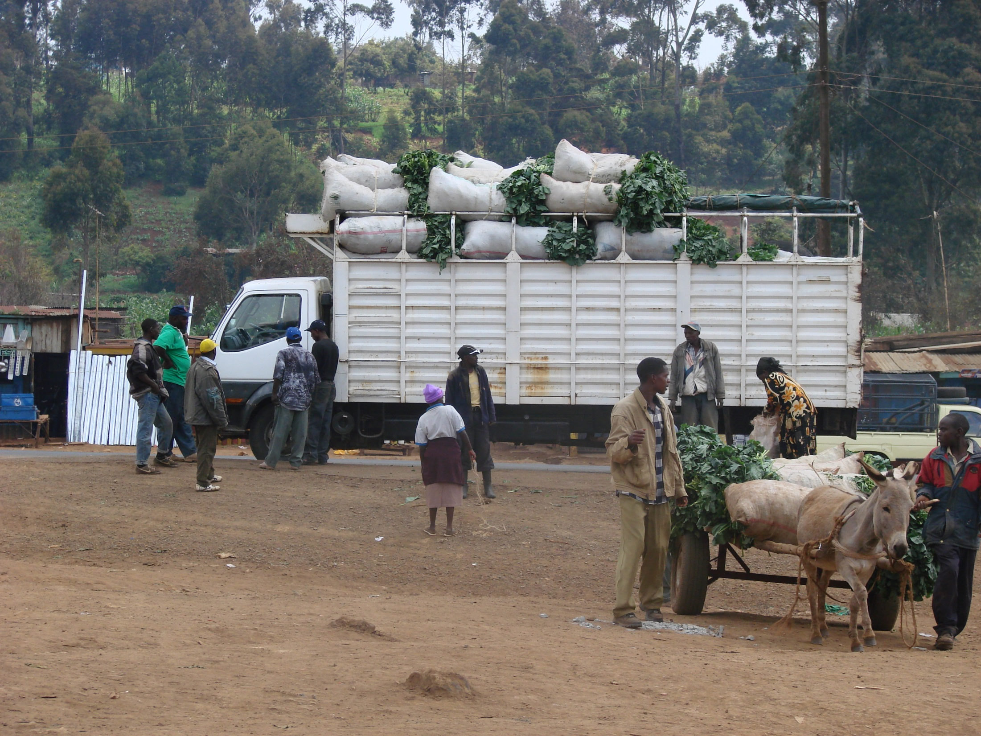
Thank you for your time, interest and insights

